Slide 1

Dark secrets of the event loop
Sofia
Nov 23, 2019

Slide 2


























Thanks to our Sponsors:
Hosting Partner:
General Sponsor:
Innovation Sponsor:
Trusted Sponsor:
Strategic R&D Sponsor:
Gold Sponsors:
Silver Sponsors:
Bronze Sponsors:
Automotive Partner:
Technological Partners:
In-Kind:
Sofia
Nov 23, 2019

Slide 3


uncovering the secrets with you today are:
Dragan Gelevski
Vekoslav Stefanovski @swekster
Head of Development at Sourcico
Coordinator at SEDC
Avid debater
Full Stack Developer at iborn.net
Trainer at SEDC
Tea aficionado
Sofia
Nov 23, 2019

Slide 4
What's happening with our Javascript code?!
Who is executing the code? How many threads are there? How are things working asynchronously? Why happens with callbacks?

Slide 5
Javascript - Not what it used to be
Sofia
Nov 23, 2019
Started from a small interpreted scripting language to act as a companion of Java and now:
It is a standard for the whole web
Complex engines compile and execute it
Frameworks and libraries are growing in numbers every day
The question is what changed and how does modern JavaScript works now? Can we optimize it and help engines run better?

Slide 6
The only one
Last in - first out
01
The call stack
Can be blocked
Sofia
Nov 23, 2019
Javascript code must end up here in order for it to be executed
Tasks execute by the last in first out principle
One stack to rule all javascript
Tasks that take a lot of time block the stack

Slide 7

The call stack
function sayHello(name, isAlert){
let text = `Hello ${name}`;
if(isAlert === true) {
alert(text);
return;
}
console.log(text);
}
function first(){
second();
}
function second(){
third();
}
function third(){
sayHello("Bob");
}
first();
Sofia
Nov 23, 2019

Slide 8
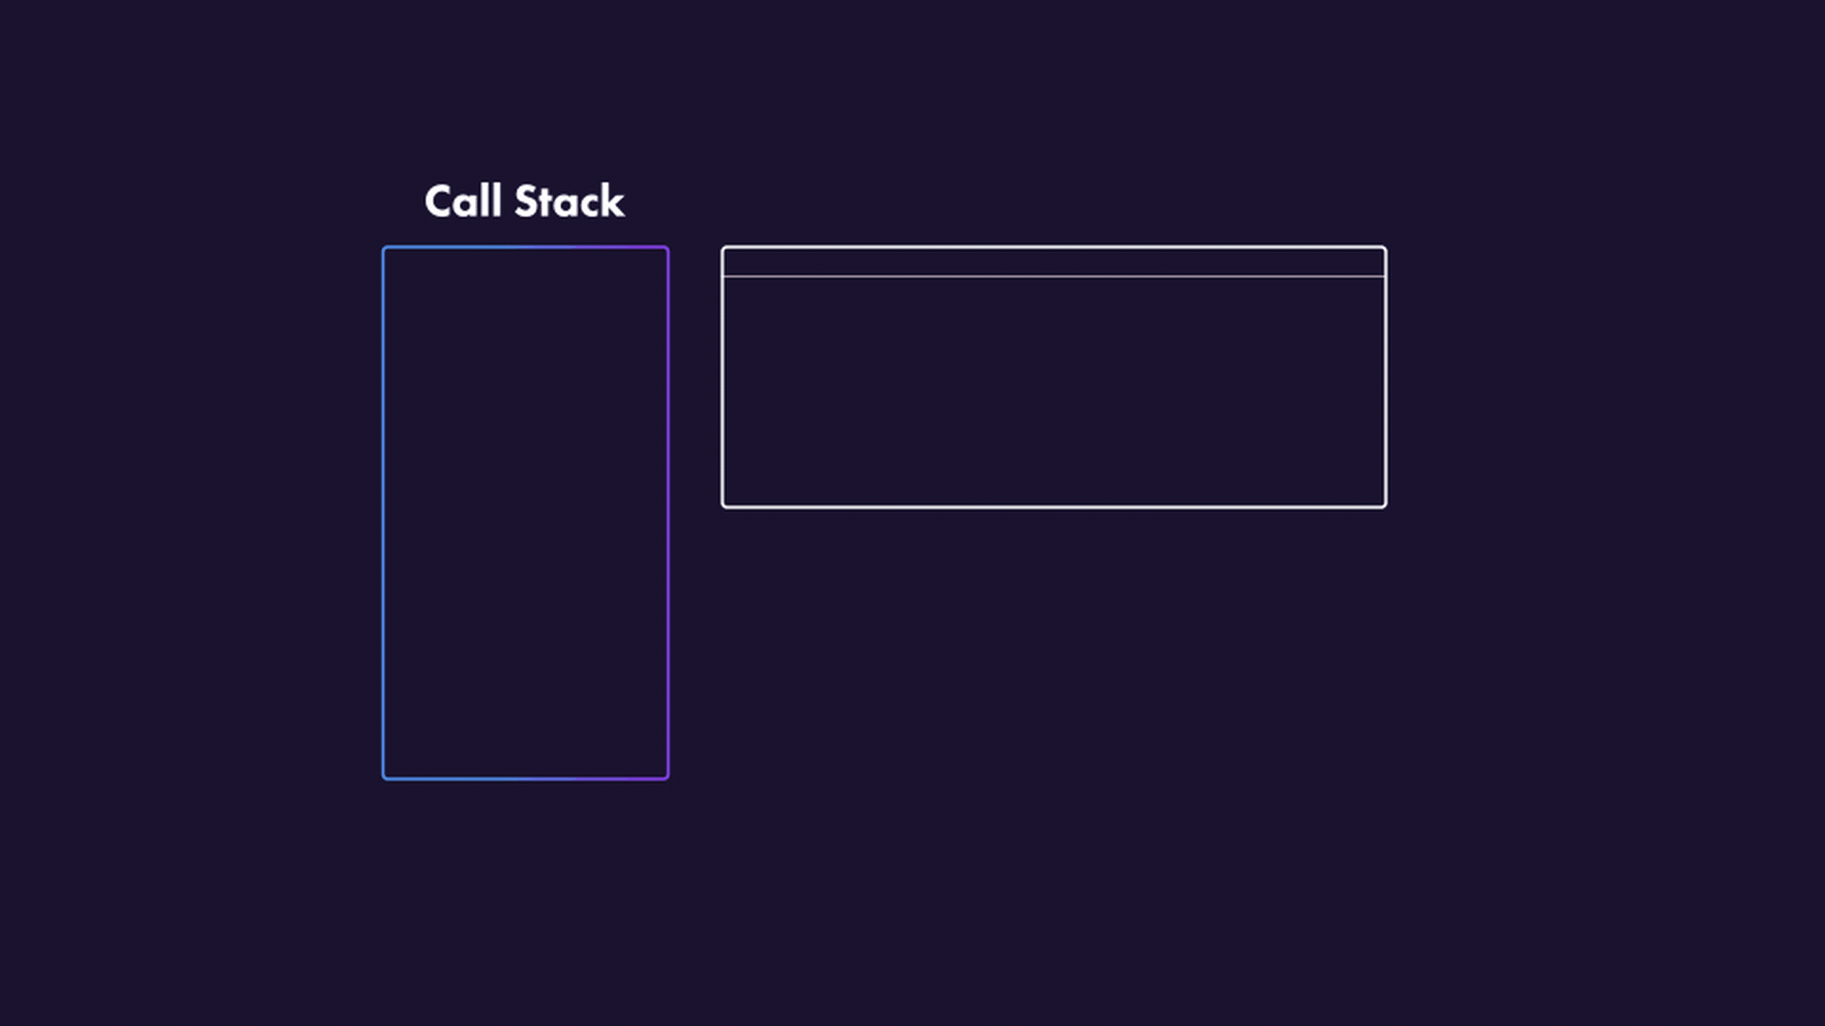
The call stack

Slide 9
The call stack
function fibonacci(num){
if (num < 2) return num;
return fibonacci(num - 1) + fibonacci(num - 2);
}
function fibonacci(num){
if (num < 2) return num;
return fibonacci(num - 1) + fibonacci(num - 2);
}
function first(){
second();
}
function second(){
third();
}
function third(){
fibonacci(40);
sayHello("Bob");
}
first();
Sofia
Nov 23, 2019

Slide 10
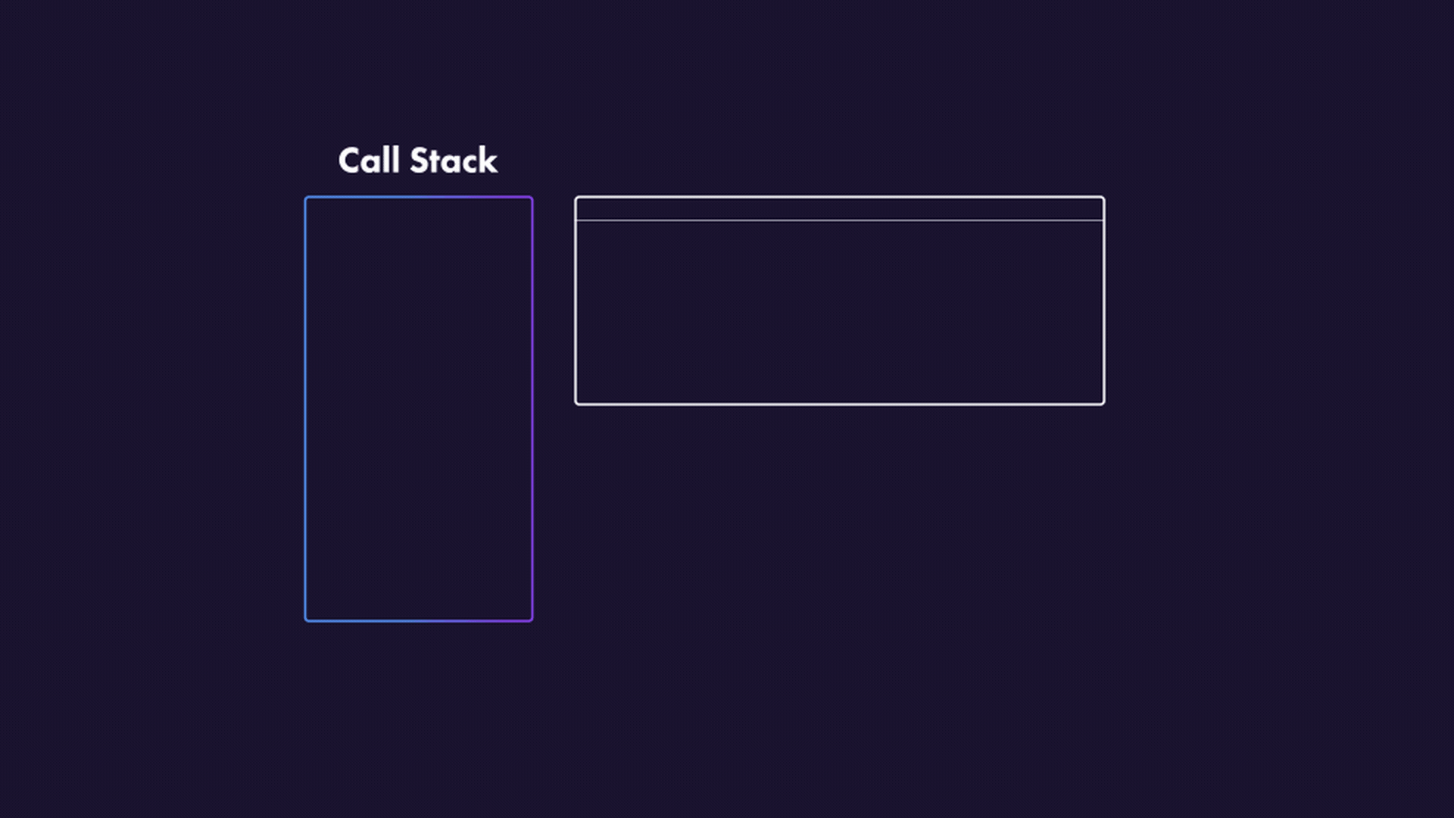
The call stack

Slide 11
help the stack
callback at the right time
02
Features support
Web/NODE apis
Sofia
Nov 23, 2019
Tasks that would usually block the stack are delegated to the APIs
When the waiting is done or an event is triggered a callback is sent to the stack
There is support for all the blocking functions that depend on waiting such as:
setTimeout()
setInterval()
XMLHttpRequest
The desperately needed help

Slide 12
APIs to task queue
First in - first out
03
Task queue
tasks wait for the stack
One at a time
Sofia
Nov 23, 2019
Before entering the stack tasks ( callbacks ) that come from the APIs are queued in the task queue
Tasks are added to the stack from the oldest one first to the newest one last
The waiting room for tasks
Tasks are waiting for the stack to finish with it’s previous work in order to get in
Tasks are added to the stack one at a time

Slide 13
Task queue and APIs
btn.addEventListener("click", function(){
console.log("Clicked the button");
});
btn.addEventListener("mouseover", function(){
console.log("Mouse over the button!");
});
Sofia
Nov 23, 2019

Slide 14
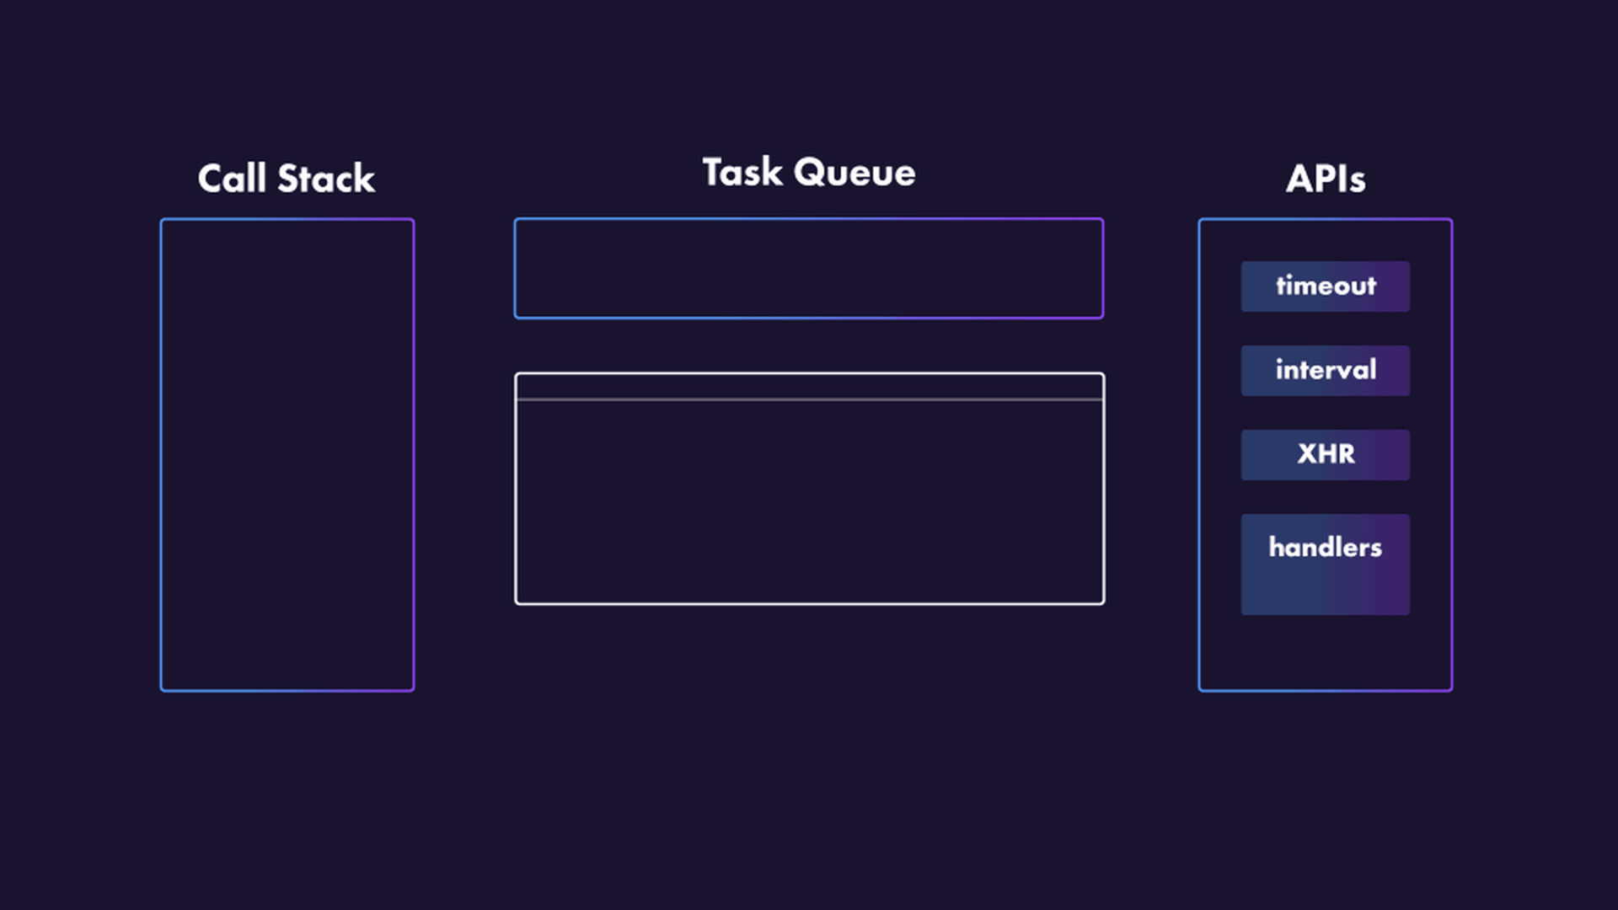
Task queue and APIs

Slide 15
Task queue and APIs
let wait2s = _ => setTimeout(_ => console.log("After ~2 seconds"), 2000);
let wait3s = _ => setTimeout(_ => console.log("After ~3 seconds"), 3000);
let wait6s = _ => setTimeout(_ => console.log("After ~6 seconds"), 6000);
btn.addEventListener("click", function(){
wait2s();
wait3s();
wait6s();
});
Sofia
Nov 23, 2019

Slide 16
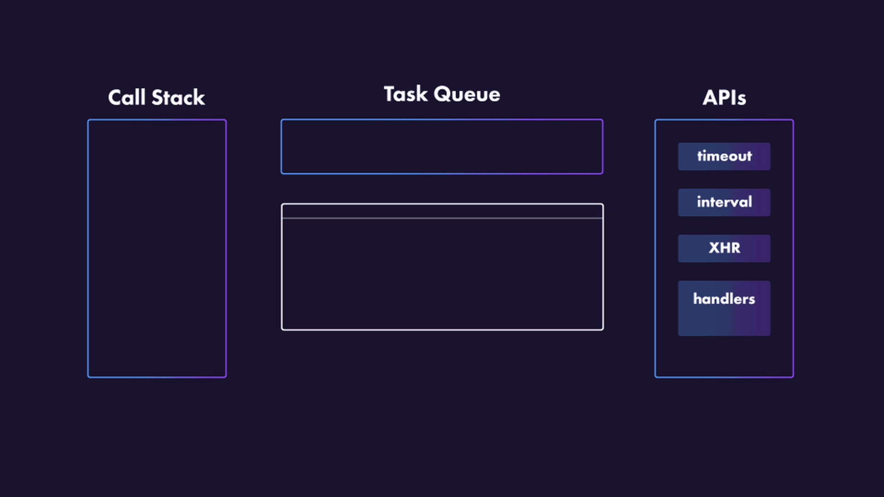
Task queue and APIs

Slide 17
01
check if stack is empty
02
task from task queue
04
EVENT LOOP
All tasks from microtask queue
03
04
RENDER steps
Sofia
Nov 23, 2019
The event loop checks if the stack is empty. If it is it goes to the task queue
It gets the oldest task from the task queue and adds it on the stack to execute
After executing the task it checks if there are any microtasks and executes them all
The mastermind of the operation
The event loop controls when should the page be rendered on the screen again

Slide 18
is after processing a task
all microtasks are completed
05
Microtask queue
the way promises work
Sofia
Nov 23, 2019
The microtask queue is called after a task has been queued in the task queue
Unlike the task queue where one task is completed every cycle, all microtasks are added and completed in one cycle
The new ( and a bit weird ) queue on the block
Working and waiting on promises is done through the microtasks instead of waiting on promises on the main task queue

Slide 19
Event loop
btn.addEventListener("click", function(){ fetch('http://slowwly.robertomurray.co.uk/delay/6000/url/https://swapi.co/api/people/1')
.then(function a() { console.log("Got it!")});
});
Sofia
Nov 23, 2019

Slide 20
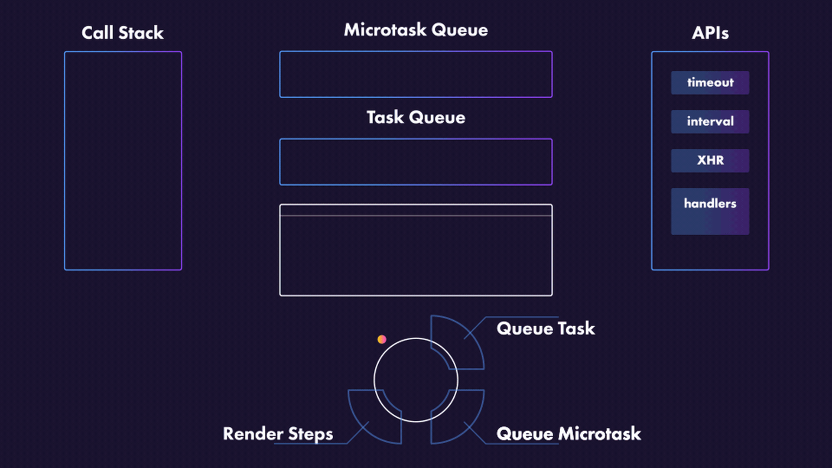
Event loop

Slide 21
Event loop decides when
Render tree
06
Painting the screen
Render steps
manipulating animation frames
Sofia
Nov 23, 2019
The event loop decides when it is appropriate to render a screen depending on the display refresh rate
A DOM tree is constructed as well as a CSSOM tree. Both of them are combined to create a render tree
The screen is painted by the instructions in the render tree
The steps to rendering a screen
To force a code upon the next frame, a method is used called requestAnimationFrame(). There is also a function cancelAnimationFrame() that cancels the previously scheduled request

Slide 22
RENDER STEPS
let red = _ => element.style.backgroundColor = "red";
let yellow = _ => element.style.backgroundColor = "yellow";
let green = _ => element.style.backgroundColor = "green";
btn.addEventListener("click", function(){
red();
yellow();
green();
});
Sofia
Nov 23, 2019

Slide 23
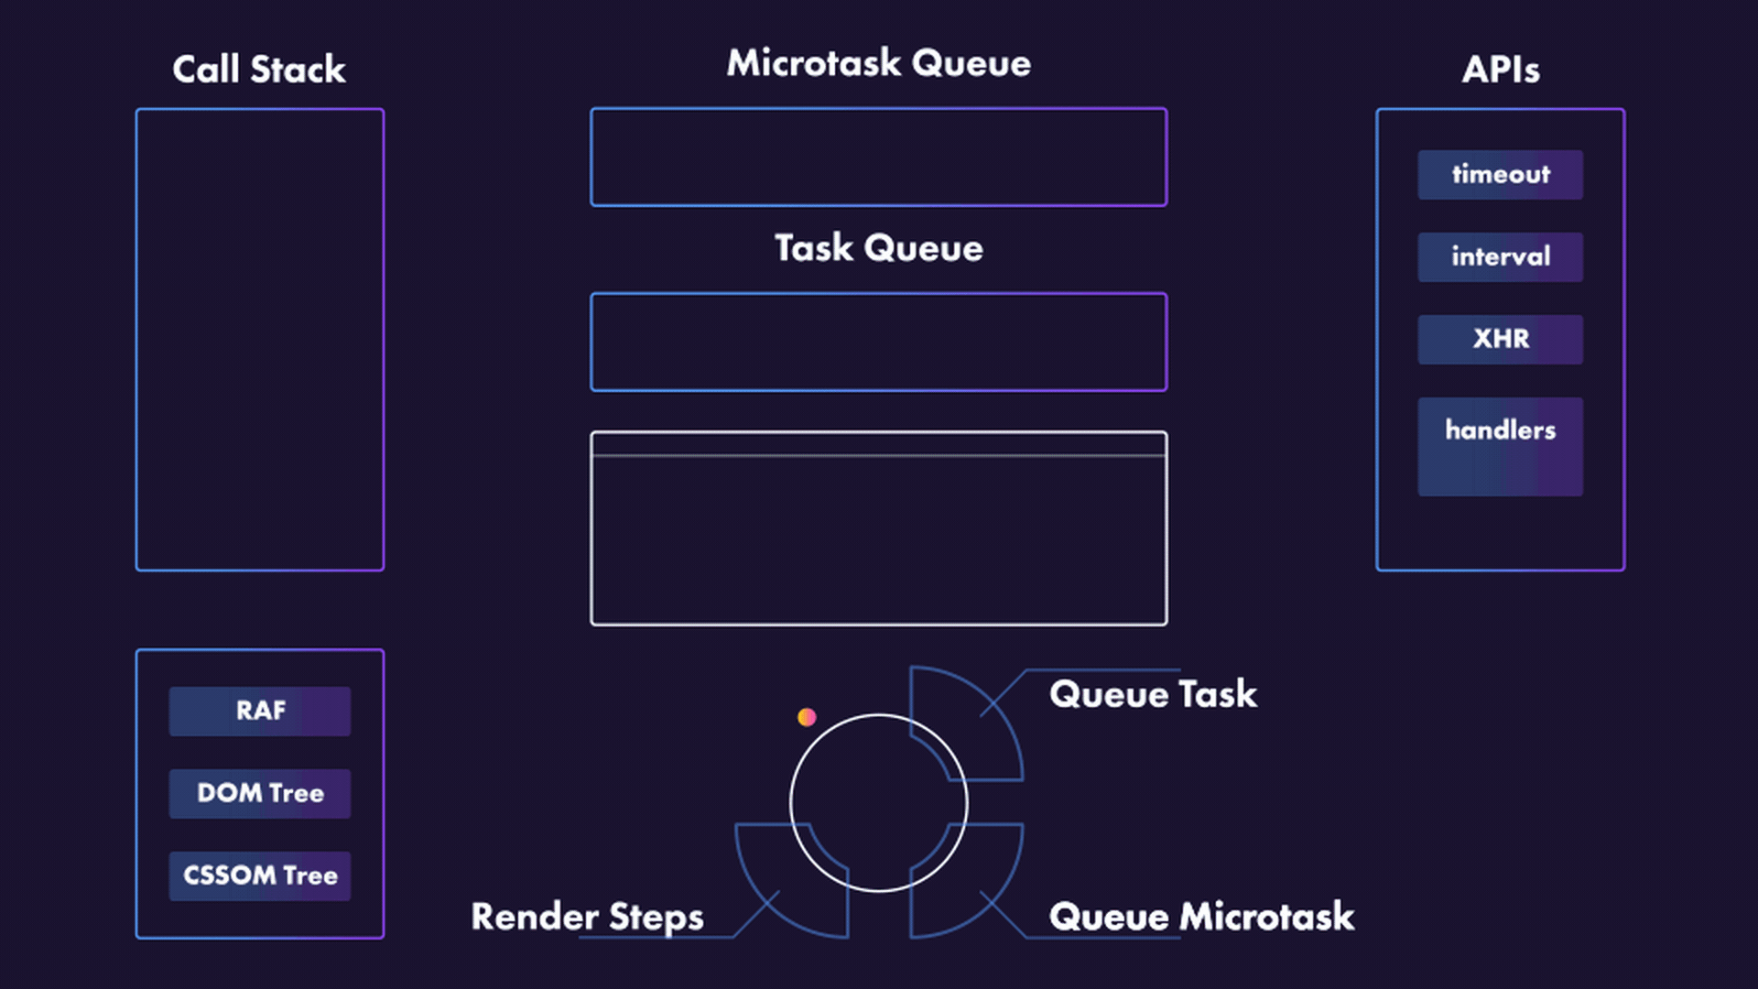
Render Steps

Slide 24
THE V8 ENGINE
Sofia
Nov 23, 2019
The beating heart of Google Chrome and Node.js

Slide 25
What is V8
ENGINE
Chrome and node.js
Helps javascript a lot
Sofia
Nov 23, 2019
A system built in C++ that compiles and executes javascript
Chrome and js use it to compile, execute and optimize javascript code
It has a lot of systems for detecting code, types and patterns in order to optimize and manage resources

Slide 26
Important features of v8 engine
Sofia
Nov 23, 2019
JIT Compiler
( IGNITION )
Compiler that not only compiles but executes javascript at the same time during runtime instead of first compiling and then running.
Optimizing compiler
( TURBOFAN )
Re-compiles frequently used data by comparing types. If types are different then there is a de-optimization phase.

Slide 27
Let's talk performance
Sofia
Nov 23, 2019
The history of V8 performance takes us from special dialects to easy to use tips to help the compilers optimize javascript better

Slide 28
Optimizing javascript in the v8 engine
Sofia
Nov 23, 2019
Keep up with current features
Declare classes in the global scope
Use class constructors and keep the structure
Keep order of properties consistent

Slide 29
Thanks!
Does anyone have any questions?
hello@dragan.codes
swekster@gmail.com
Sofia
Nov 23, 2019

Slide 30
Credits
Thanks to the awesome people and sites that made this amazing presentation possible:
Presentation template by Slidesgo
Icons by Flaticon
Design Jovana Shiskovska
Animations Dime Gjorgjievski

